Slide 1
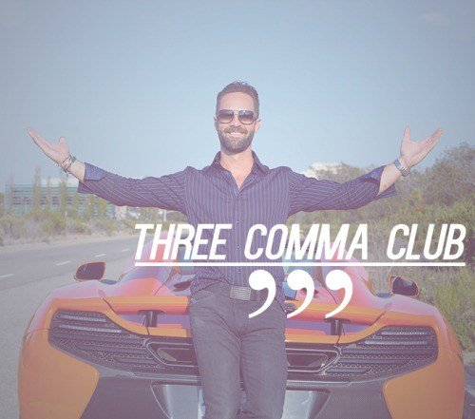

Slide 2
Vogue AI
Notes:
We need to articulate the problem/challenge/opportunity and how we are addressing this issue and what it means in terms of ROI/ some numbers/ bump up in revenue or AOV (average order value)

Slide 3
How do we get customers to spend more money?
Notes:
A combination of recommend-sell and up-sell
Customer profile is built up and nurtured through the sales process to increase customer satisfaction and retention
Same way people will buy health supplements or go to gym, this is a use of technology to enhance our health. Similarly we can use deep learning tools to enhance our style, looks and improve ROI on our fashion spend. Fashion is a reflection of who we are every day especially thru choice of what we wear

Slide 4
Customers will buy 200 percent more when they see a whole outfit
Notes:
Compared to just being shown a single product - as is common in cookies. This provides a complete ‘look’ matching with the customer persona, and is a curated collection.

Slide 5
Impossible to show every combination

Slide 6
Our Solution
Machine Learning
+
Computer Vision

Slide 7
Offering good suggestions requires a lot of data
Fit
Fabric
Color/Pattern
Vogue

Slide 8
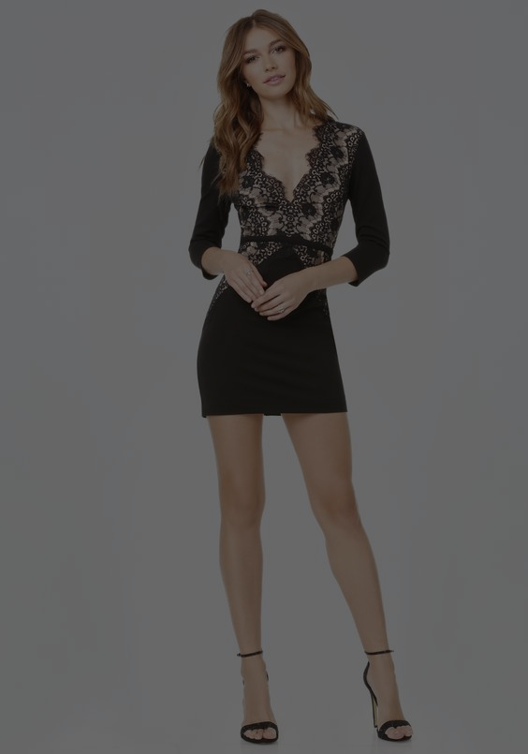
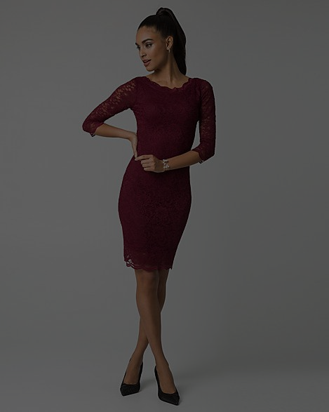
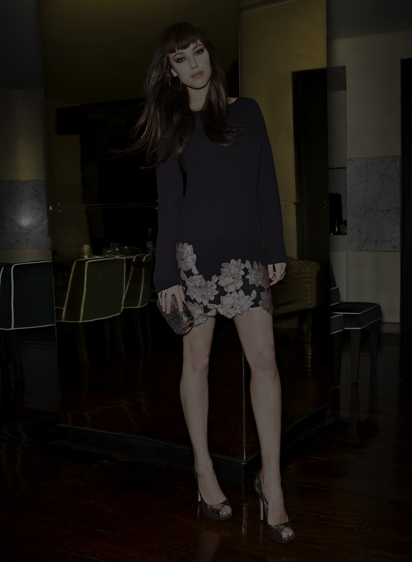
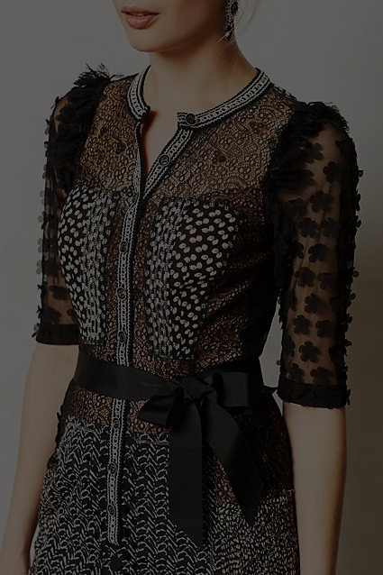

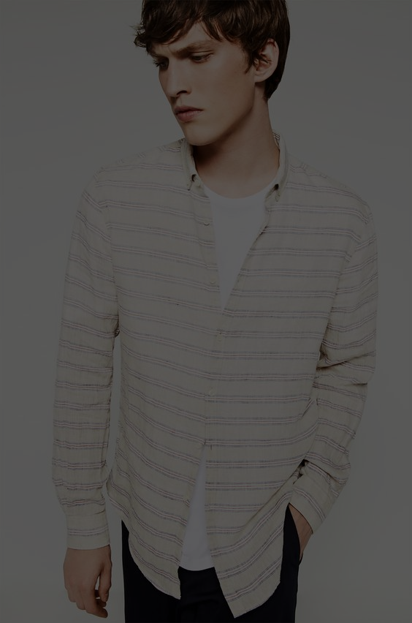
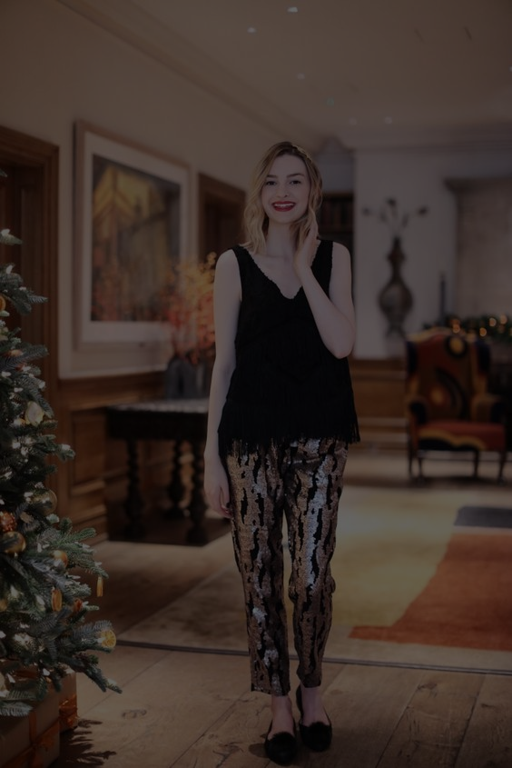
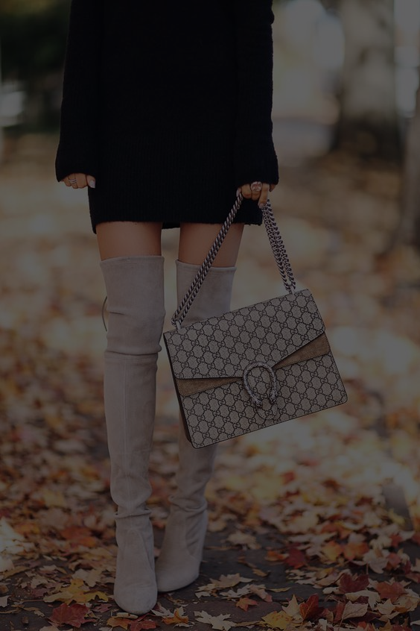
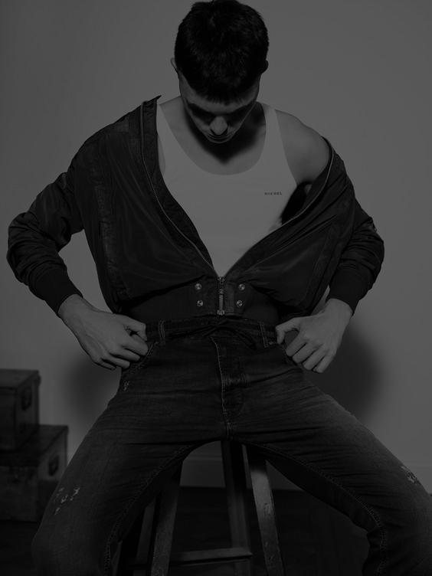
Notes:
Yorkdale - Where high-end Fashion meets cutting-edge technology to offer a unique and delightful experience!!

Slide 9
Implementation methods
Yorkdale Wifi
A web page that is only accessible when connected to Yorkdale wifi
Chat Bot
An interactive Facebook Messenger bot
Directory Screen
An interactive screen that snaps a picture
Notes:
Go to market strategy - launch of this service with a fashion pop shop in the center of the mall with reach out done by existing channels. Fashion celebrity will be invited to this event with their endorsement. Offered on a ‘select’ basis?

Slide 10
Demo

Slide 11

Thanks!
Any questions?

